Slide 1

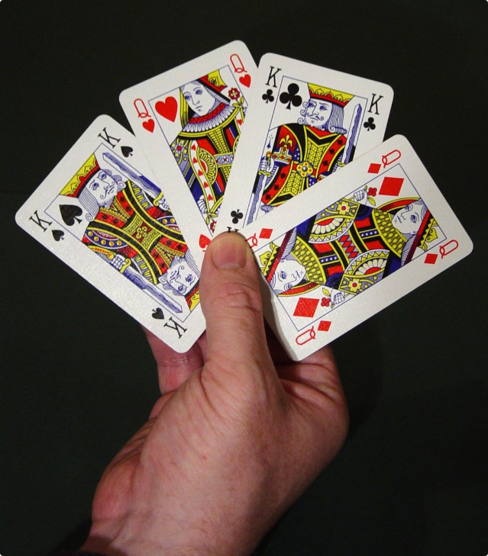
MARK 52: Play your cards right
Crafting an attractive card game takes a careful mix of exciting situations, deep artwork and interesting strategy. In this presentation, I take you on a journey of these fundamental principles and how to apply them in order to create good card games.

Slide 2

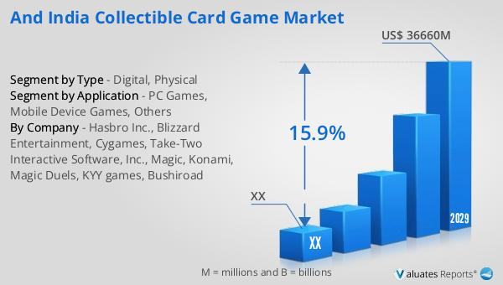
Card Game Market Analysis
Revenue of normal cards in
India
$46.10 M or 385 crore Rupees
Projected market value of
Cards in India by 2029
$104.10 M or 826 crore Rupees

Slide 3
Game Design Principles
Player Experience
Rulebook Design
Balancing Mechanics
Providing an engaging and enjoyable players’ experience is paramount. Considering elements like theme, objectives, and decision-making that keep players engaged.
Clear and precise rules enable players to grasp the game's situations and strategies effectively. Making the rulebook easily accessible is paramount .
Ensuring a well-balanced game by testing and refining core situations to provide meaningful choices and to avoid dominating strategies.

Slide 4


Gameplay Mechanics
1
Card Drawing
Determining how players gain new cards, whether through deck building, managing hands, or other situations.
2
Card Actions
Establishing the actions and effects that cards can have, such as playing or discarding cards.
3
Player Interactions
Designing ways for players to interact with each other. Like team matches.

Slide 5

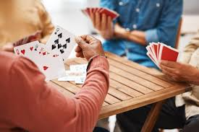
Player Interaction Dynamics
Cooperative Gameplay
Competitive Gameplay
Players compete against each other, with situations that call for direct confrontation and tactical decisions.
Players team up together to achieve a common goal, enabling teamwork and communication.
P2P Interactions
Situations that encourage players to make bargains, trades, or convince others, adding a social dimension to the game.

Slide 6


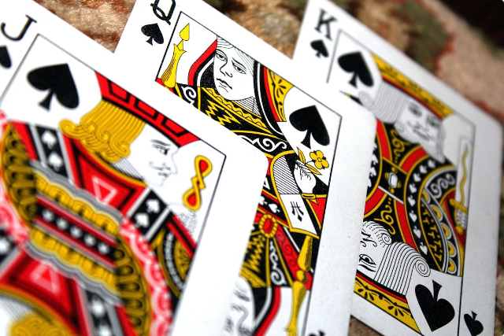


Testing and Recursion
Prototyping
Gathering feedback from players to identify design bugs and optimizing the core situations.
Balancing the Gameplay
Continuously adjusting card effects, probabilities, and other features to achieve a well-balanced game.
Easy-to-use UI
Ensuring that the game's rules, interface, and overall experience are instinctive and accessible.

Slide 7
Originality & Analysis
There are games out there which are normal card games, but as said there is no "Organized" card playing game rather more all of these games have no more than 3.5 stars and a lot of issues.
During analysis of games we found that there were many games with a lot of bugs and wrong rules.

Slide 8



Social Impact
1
Playing with Family
Nowadays, there not many games that can be played with whole family. Game for all age group that can be played together.
2
Playing with Friends
In todays fast paced world it is hard for friends to get same college or be get together many times
So this game can be played online multiplayer and it is not addictive also.

Slide 9
Conclusion
For now we conclude here but we aspire to add more……

Slide 10


